Slide 1

Chapter 3 Process Description and Control
Operating Systems: Internals and Design Principles, 6/E William Stallings
Notes:
These slides are intended to help a teacher develop a presentation. This PowerPoint covers the entire chapter and includes too many slides for a single delivery. Professors are encouraged to adapt this presentation in ways which are best suited for their students and environment.

Slide 2
Interrupt vs Trap
In any computer, during its normal execution of a program, there could be events that can cause the CPU to temporarily halt.
Events like these are called interrupts
Interrupts can be caused by either software or hardware faults.
Hardware interrupts are called (simply) Interrupts, while software interrupts are called Exceptions or Traps.

Slide 3
Interrupt vs Trap
Once an interrupt (software or hardware) is raised, the control is transferred to a special subroutine called ISR (Interrupt Service Routine) that can handle the conditions that are raised by the interrupt.

Slide 4
Interrupt vs Trap
Interrupts are hardware interrupts, while traps are software-invoked interrupts.
Occurrences of hardware interrupts usually disable other hardware interrupts, but this is not true for traps
Traps: division by zero or invalid memory access
Interrupt: hard disk, graphics card, I/O ports

Slide 5
Kernal
core component of an operating system.
it acts as a bridge between applications and the data processing performed at the hardware level.
When an OS is loaded into memory, the kernel loads first and remains in memory until the operating system is shut down again.
responsible for low-level tasks such as disk management, task management and memory management.

Slide 6
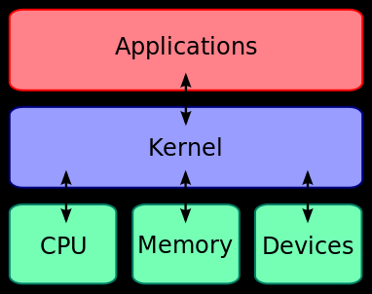
kernel
kernel is a computer program that manages I/O (input/output) requests from software, and translates them into data processing instructions for the central processing unit and other electronic components of a computer.

Slide 7
Kernel mode
In Kernel mode, the executing code has complete and unrestricted access to the underlying hardware.
It can execute any CPU instruction and reference any memory address.
Kernel mode is generally reserved for the lowest-level, most trusted functions of the operating system.
Crashes in kernel mode are catastrophic; they will halt the entire PC.
.

Slide 8
User mode
In User mode, the executing code has no ability to directly access hardware or reference memory.
Code running in user mode must delegate to system APIs to access hardware or memory.
Due to the protection afforded by this sort of isolation, crashes in user mode are always recoverable.
Most of the code running on your computer will execute in user mode

Slide 9
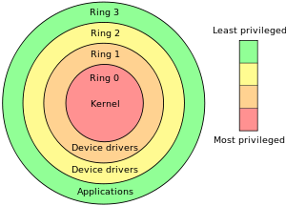

Slide 10
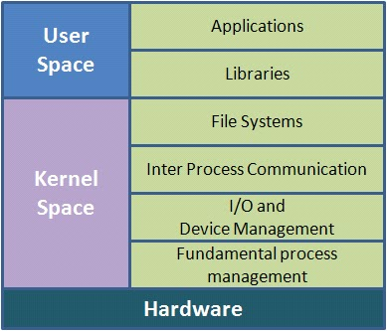
Monolithic kernels
Monolithic kernels :mono means everything put together in one huge unit that is called the monolithic. Monolithic kernel contains all of the services like process management, file management, Scheduler, Virtual memory etc. in kernel space.
drawbacks.
· The kernel size increase.
· Lack of extensibility.
· bad maintainability

Slide 11
Microkernels
only small portion of basic services(lets call them primitive services) are put into kernel space and remaining services goes to the user space. The user space facilities are called as servers.
When any request comes which cannot be served by the kernel, the primitive kernel passes the message to the related server, which in turn would gets the requested work done.

Slide 12
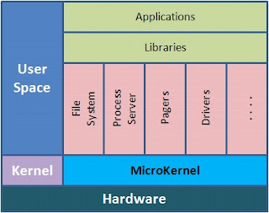
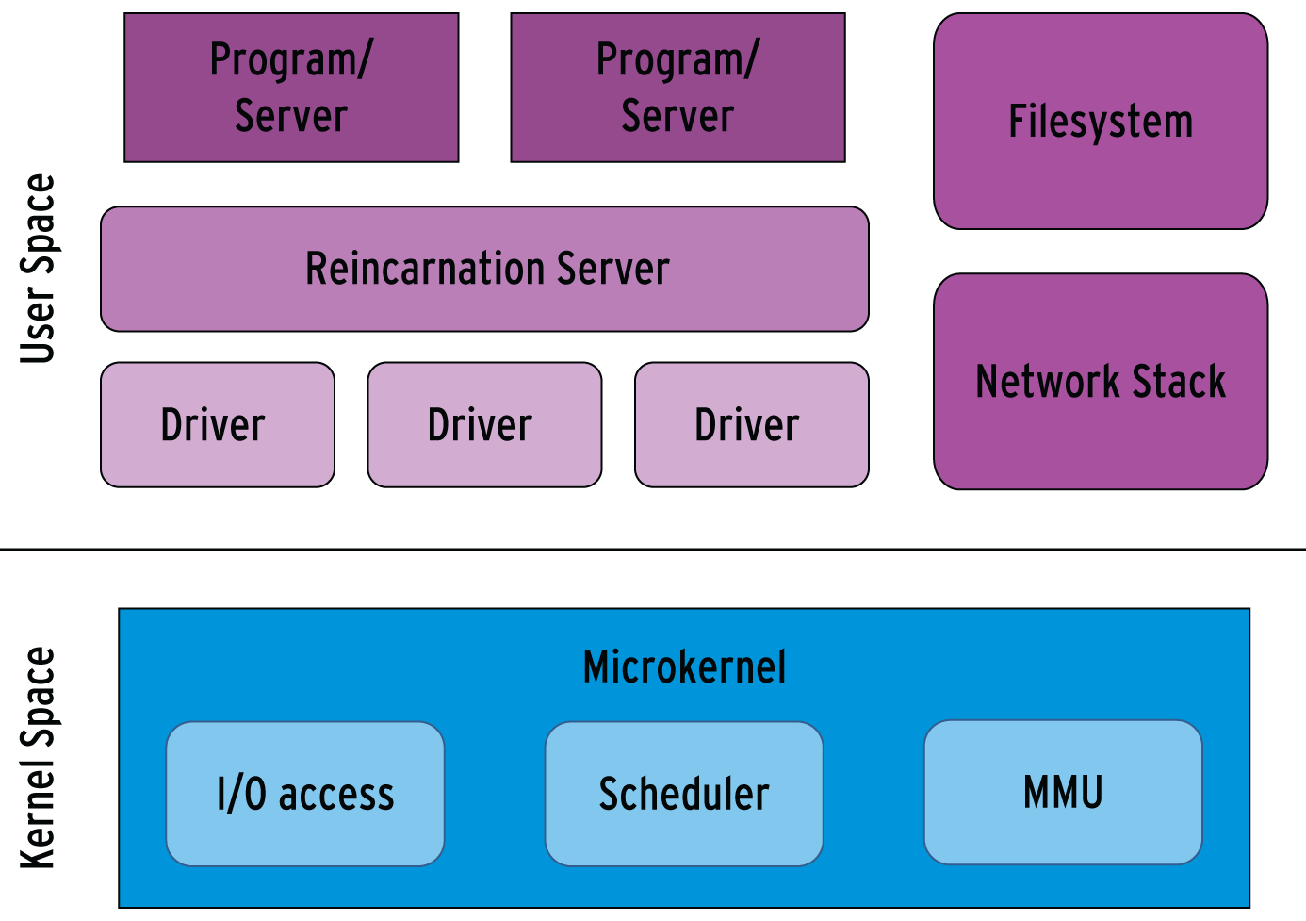

Slide 13
Micro kernel vs Monolithic kernels
Memory management : In case of Mono kernel everything in the kernel space. Micro kernels only keeps the basic of the facility in kernel code and remaining is implemented in the user space.
Security and stability : if one of the process crashes in process management module; then, in case of monolithic kernel whole system goes down. But in case of micro, we still have a chance that kernel will be active as most of the work is done in user address space.

Slide 14
Micro kernel vs Monolithic kernels
Extensibility and Portability : extensibility is the most important factor of micro kernel. Adding new features to a monolithic system means recompilation of the whole kernel, often including the whole driver infrastructure. In case of a micro kernel the services are isolated from each other through the message system. It is enough to re-implement the new memory manager. The processes which formerly used the other manager, do not notice the change. micro kernels also show their flexibility in removing features . That way a micro kernel can be the base of a desktop operating system and as well as of real time appliances in single chip systems.

Slide 15
System Call
A computer operates in two modes: user mode and kernel mode. The execution of a program is in the user mode. When the program requires RAM or a hardware resource, it sends a request to the kernel and the mode changes from user mode to kernel mode. System calls refer to these requests. After completing the task, the mode changes back to the user mode. Likewise, the mode changes continuously. This transition is also called context switching.

Slide 16
various types of system calls
Process control system calls – Create, execute, terminate processes, set process attributes, etc.
File management system calls – Create, read, write, delete files, open and close files, set file attributes, etc.
Device management system calls – Request and release devices, set device attributes, etc.
Information management system calls – Get and set system data, get and set time and date, etc.
Communication system calls – Send and receive messages, transfer status information, create and delete communication connections, etc.

Slide 17
API
API (Application Programming Interface) helps to establish connectivity among devices and applications. Moreover, it is an interface that takes the requests from the user and informs the system about what should be done and return the response back to the user.

Slide 18
Difference Between API and System Call
API is a set of protocols, routines, functions that allow exchanging data among various applications and devices
system call is a method that allows a program to request services from the kernel.

Slide 19
Chapter 3 Process Description and Control

Slide 20
Roadmap
How are processes represented and controlled by the OS.
Process states which characterize the behaviour of processes.
Data structures used to manage processes.
Ways in which the OS uses these data structures to control process execution.
Discuss process management in UNIX SVR4.
Notes:
Note: In this chapter, reference is occasionally made to virtual memory. Much of the time, we can ignore this concept in dealing with processes, but at certain
points in the discussion, virtual memory considerations are pertinent. Virtual memory is not discussed in detail until Chapter 8.
Refer students to a brief overview which is provided in Chapter 2.

Slide 21
What is a “process”?
A program in execution
An instance of a program running on a computer
The entity that can be assigned to and executed on a processor
A unit of activity characterized by the execution of a sequence of instructions, a current state, and an associated set of system instructions

Slide 22
Process Elements
A process is comprised of:
Program code (possibly shared)
A set of data
A number of attributes describing the state of the process

Slide 23
Process Elements
While the process is running it has a number of elements including
Identifier
State
Priority
Program counter
Memory pointers- pointers to the program code and data associated with this process, plus any memory blocks shared with other processes
Context data- data that are present in registers in the processor
I/O status information
Accounting information-It includes the amount of processor time and clock time used, time limits, account numbers, and so on.
Notes:
Mention that this list is not necessarily complete, and may include optional elements (e.g. not all OS’s may need a process to have accounting information)

Slide 24
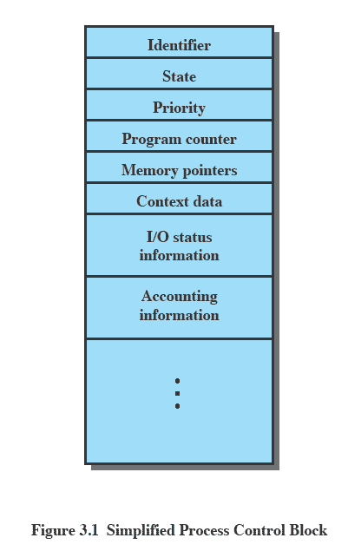
Process Control Block
Contains the process elements
Created and manage by the operating system
Allows support for multiple processes
Notes:
Emphasise that the Process Control Block contains sufficient information so that it is possible to interrupt a running process and later resume execution as if the interruption had not occurred.

Slide 25
Trace of the Process
The behavior of an individual process is shown by listing the sequence of instructions that are executed
This list is called a Trace
Dispatcher is a small program which switches the processor from one process to another

Slide 26
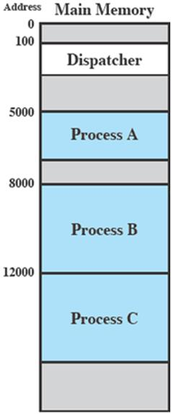
Process Execution
Consider three processes being executed
All are in memory (plus the dispatcher)
Lets ignore virtual memory for this.

Slide 27
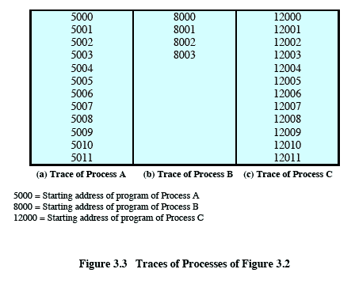
Trace from the processes point of view:
Each process runs to completion
Notes:
Animated slide
Wipes down to give impression of process progression

Slide 28
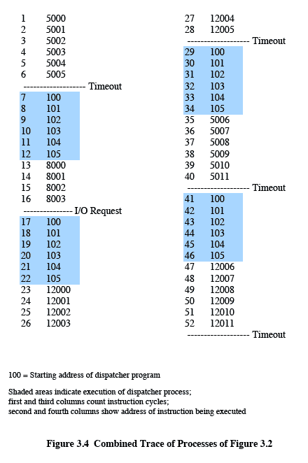
Trace from Processors point of view
Timeout
Timeout
Timeout
I/O
Notes:
Animated slide
Explain the scenario then click for the animation
The shaded areas represent code executed by the dispatcher.
The same sequence of instructions is executed by the dispatcher in each instance because the same functionality of the dispatcher is being executed.
We assume that the OS only allows a process to continue execution for a maximum of six instruction cycles, after which it is interrupted; this prevents any single process from monopolizing processor time.
Animate here
The first six instructions of process A are executed, followed by a time-out and the execution of some code in the dispatcher, which executes six instructions before turning control to process B2.
After four instructions are executed, process B requests an I/O action for which it must wait. Therefore, the processor stops executing process B and moves on, via the dispatcher, to process C.
After a time-out, the processor moves back to process A. When this process times out, process B is still waiting for the
I/O operation to complete, so the dispatcher moves on to process C again.

Slide 29
Roadmap
How are processes represented and controlled by the OS.
Process states which characterize the behaviour of processes.
Data structures used to manage processes.
Ways in which the OS uses these data structures to control process execution.
Discuss process management in UNIX SVR4.
Notes:
Progress indicator

Slide 30
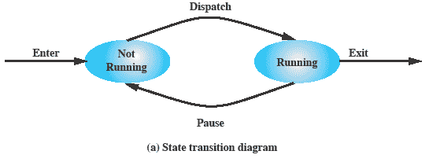
Two-State Process Model
Process may be in one of two states
Running
Not-running
Notes:
Emphasize that you are introducing a Simple model and that this will be expanded.
The operating system’s principal responsibility is controlling the execution of processes;
this includes determining the interleaving pattern for execution and allocating resources to processes.
The first step in designing an OS to control processes is to describe the behaviour that we would like the processes to exhibit. In the most simple model, a process is either running, or it is not.

Slide 31
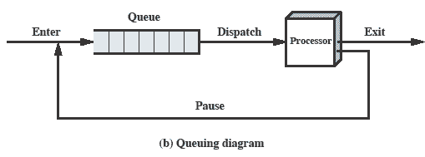
Queuing Diagram
Etc … processes moved by the dispatcher of the OS to the CPU then back to the queue until the task is competed
Notes:
Animated slide The animation only shows one process moving.
There needs to be some structure so that the OS can keep track of the processes. This could be a simple queue which is managed by the dispatcher routine of the OS.

Slide 32
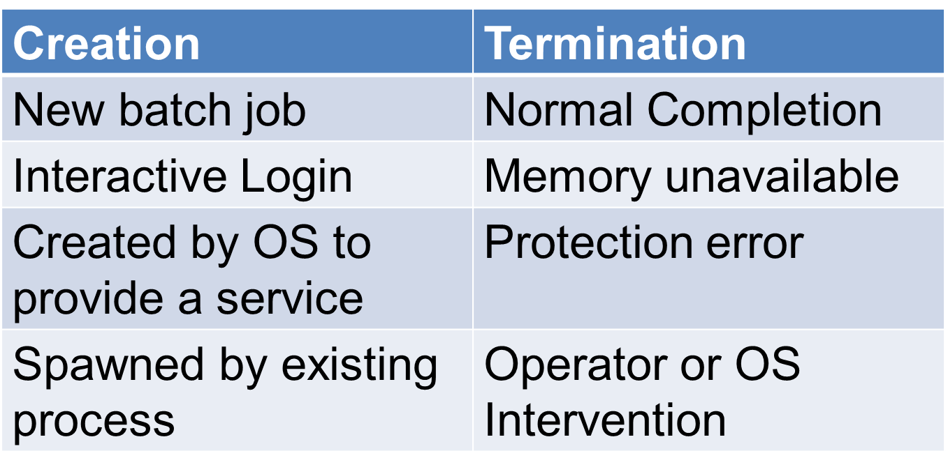
Process Birth and Death

Slide 33
Process Creation
The OS builds a data structure to manage the process
Traditionally, the OS created all processes
But it can be useful to let a running process create another
This action is called process spawning
Parent Process is the original, creating, process
Child Process is the new process
Notes:
Typically, the “related” processes need to communicate and cooperate with each other. Achieving this cooperation is a difficult task for the programmer; discussed further in Chapter 5.

Slide 34
Process Termination
There must be some way that a process can indicate completion.
This indication may be:
A HALT instruction generating an interrupt alert to the OS.
A user action (e.g. log off, quitting an application)
A fault or error
Parent process terminating

Slide 35
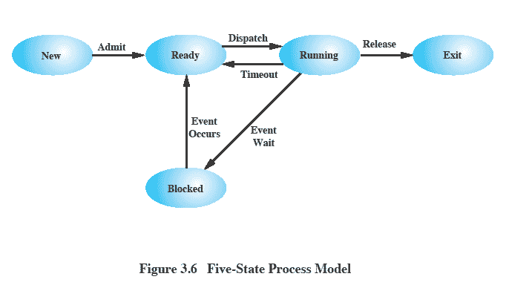
Five-State Process Model
Notes:
If all processes were always ready to execute, then the simple FIFO queuing model would suffice.
However, even with simple examples, this implementation is inadequate:
some processes in the Not Running state are ready to execute,
while others are blocked, waiting for an I/O operation to complete.
In a two state model, the dispatcher would have to scan the list looking for the process that is not blocked and that has been in the queue the longest.
But we could split the Not Running state into two states:
Ready and
Blocked.
For good measure, we have added two additional states that will prove useful (new and exit)
Suggestion:
Mention that “Wait” and “Blocked” have the same meaning here.
Talk through the state transitions.

Slide 36
Five-State Process Model
New:
A process that has just been created but has not yet been admitted to the pool of executable processes by the OS. Typically, a new process has not yet been loaded into main memory, although its process control block has been created.
Ready:
A process that is prepared to execute when given the opportunity.
Running:
The process that is currently being executed.
Blocked/Waiting:
A process that cannot execute until some event occurs, such as the completion of an I/O operation.
Exit:
A process that has been released from the pool of executable processes by the OS, either because it halted or because it aborted for some reason.

Slide 37
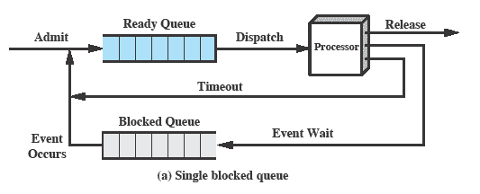
Using Two Queues
Notes:
In the simplest solution, this model would require an additional queue for the blocked processes.
But when an event occurs the dispatcher would have to cycle through the entire queue to see which process is waiting for the event.
This can cause huge overhead when their may be 100’s or 1000’s of processes

Slide 38
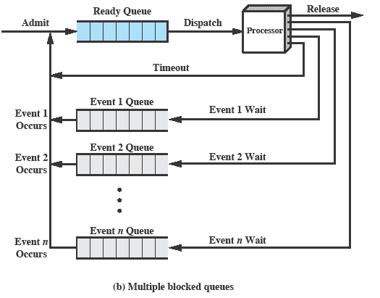
Multiple Blocked Queues
Notes:
More efficient to have a separate ‘blocked’ queue for each type of event.

Slide 39
Suspended Processes
Processor is faster than I/O so all processes could be waiting for I/O
Swap these processes to disk to free up more memory and use processor on more processes
Blocked state becomes suspend state when swapped to disk
Two new states
Blocked/Suspend
Ready/Suspend
Notes:
Mention that the aim is to fully utilize the processor.

Slide 40
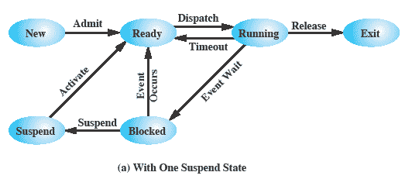
One Suspend State
Notes:
Again, the simple solution is to add a single state – but this only allows processes which are blocked to be swapped out.

Slide 41
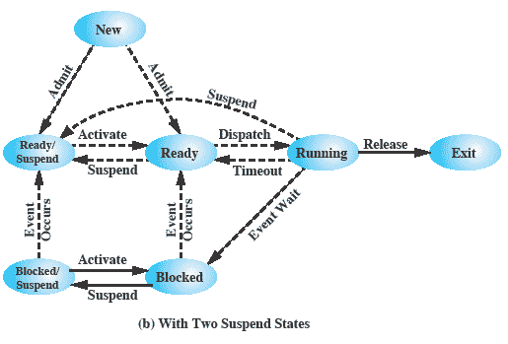
Two Suspend States
Notes:
Two suspend states allow all processes which are not actually running to be swapped.
Run through the four states:
Ready: The process is in main memory and available for execution.
• Blocked: The process is in main memory and awaiting an event.
• Blocked/Suspend: The process is in secondary memory and awaiting an event.
• Ready/Suspend: The process is in secondary memory but is available for execution as soon as it is loaded into main memory.
It would be useful to also summarise the main transitions (abridged)
Blocked → Blocked/Suspend: If there are no ready processes, then at least one blocked process is swapped out to make room for another process that is not blocked. This transition can be made even if there are ready processes available, if the OS determines that the currently running process or a ready process that it would like to dispatch requires more main memory to maintain adequate performance.
Blocked/Suspend → Ready/Suspend: A process in the Blocked/Suspend state is moved to the Ready/Suspend state when the event for which it has been waiting occurs.
Ready/Suspend S → Ready: When there are no ready processes in main memory, or if a suspended process has a higher priority, the OS will need to bring one in to continue execution.
Ready → Ready/Suspend: Normally, the OS would prefer to suspend a blocked process rather than a ready one, because the ready process can now be executed, whereas the blocked process is taking up main memory space and cannot be executed. However, it may be necessary to suspend a ready process if that is the only way to free up a sufficiently large block of main memory.
Several other transitions that are worth considering are the following:
New → Ready/Suspend and New →Ready: When a new process is created, it can either be added to the Ready queue or the Ready/Suspend queue. In either case, the OS must create a process control block and allocate an address space to the process. It might be preferable for the OS to perform these housekeeping duties at an early time, so that it can maintain a large pool of processes that are not blocked. With this strategy, there would often be insufficient room in main memory for a new process; hence the use of the (New → Ready/Suspend) transition.
Blocked/Suspend → Blocked: Inclusion of this transition may seem to be poor design. After all, if a process is not ready to execute and is not already in main memory, what is the point of bringing it in? But consider the following scenario:
A process terminates, freeing up some main memory.
There is a process in the (Blocked/Suspend) queue with a higher priority than any of the processes in the (Ready/Suspend) queue and
the OS has reason to believe that the blocking event for that process will occur soon.
Under these circumstances, it would seem reasonable to bring a blocked process into main memory in preference to a ready process.
Running → Ready/Suspend: Normally, a running process is moved to the Ready state when its time allocation expires. If, however, the OS is pre-empting the process because a higher-priority process on the Blocked/Suspend queue has just become unblocked, the OS could move the running process directly to the (Ready/Suspend) queue and free some main memory.
Any State → Exit: Typically, a process terminates while it is running, either because it has completed or because of some fatal fault condition. However, in some operating systems, a process may be terminated by the process that created it or when the parent process is itself terminated. If this is allowed, then a process in any state can be moved to the Exit state.

Slide 42
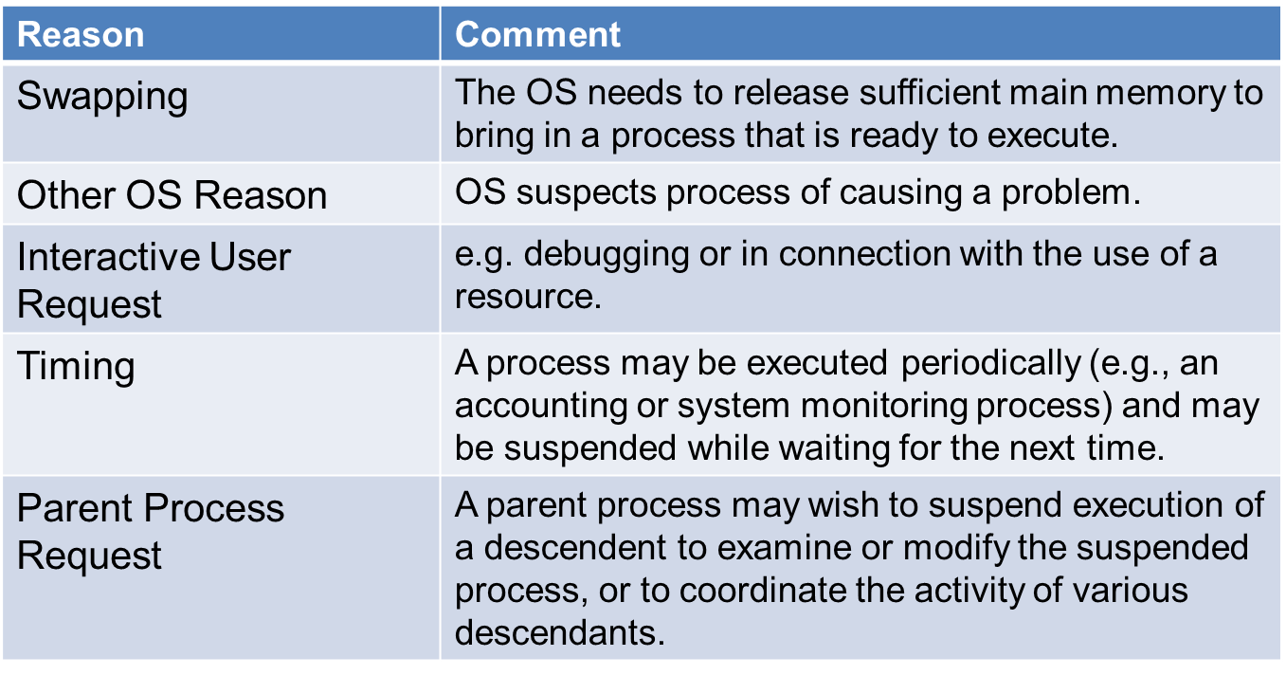
Reason for Process Suspension

Slide 43
Roadmap
How are processes represented and controlled by the OS.
Process states which characterize the behaviour of processes.
Data structures used to manage processes.
Ways in which the OS uses these data structures to control process execution.
Discuss process management in UNIX SVR4.
Notes:
Progress indicator

Slide 44
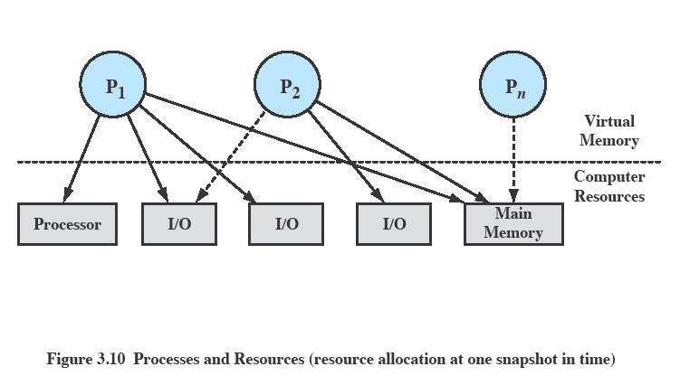
Processes and Resources
Notes:
The OS controls events within the computer system. It schedules and dispatches processes for execution by the processor, allocates resources to processes, and responds
to requests by user processes for basic services.
Fundamentally, we can think of the OS as that entity that manages the use of system resources by processes.
In this slide –
There are a number of processes (P1, . . ., Pn,) that have been created and exist in virtual memory.
Each process, during the course of its execution, needs access to certain system resources, including the processor, I/O devices, and main memory.
In the figure, process P1 is running; at least part of the process is in main memory, and it has control of two I/O devices.
Process P2 is also in main memory but is blocked waiting for an I/O device allocated to P1.
Process Pn has been swapped out and is therefore suspended.

Slide 45
Operating System Control Structures
For the OS is to manage processes and resources, it must have information about the current status of each process and resource.
Tables are constructed for each entity the operating system manages

Slide 46
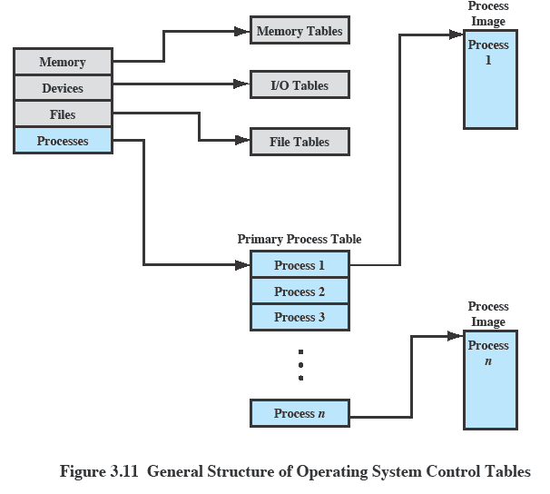
OS Control Tables
Notes:
A general idea of the scope of the tables is in Figure 3.11, which shows four different types of tables maintained by the OS:
memory,
I/O,
file,
process.
Although the details will differ from one OS to another, fundamentally, all operating systems maintain information in these four categories.
The next few slides mention details of these four tables.
You may prefer to stick with this diagram and discuss each from here

Slide 47
Memory Tables
Memory tables are used to keep track of both main and secondary memory.
Must include this information:
Allocation of main memory to processes
Allocation of secondary memory to processes
Protection attributes for access to shared memory regions
Information needed to manage virtual memory
Notes:
Memory tables are used to keep track of both main (real) and secondary (virtual) memory.
Some of main memory is reserved for use by the OS; the remainder is available for use by processes.
Processes are maintained on secondary memory using some sort of virtual memory or simple swapping mechanism.

Slide 48
I/O Tables
Used by the OS to manage the I/O devices and channels of the computer.
The OS needs to know
Whether the I/O device is available or assigned
The status of I/O operation
The location in main memory being used as the source or destination of the I/O transfer
Notes:
I/O tables are used by the OS to manage the I/O devices and channels of the computer system.
At any given time, an I/O device may be available or assigned to a particular process.
If an I/O operation is in progress, the OS needs to know the status of the I/O operation and the location in main memory being used as the
source or destination of the I/O transfer.

Slide 49
File Tables
These tables provide information about:
Existence of files
Location on secondary memory
Current Status
other attributes.
Sometimes this information is maintained by a file management system
Notes:
The OS may also maintain file tables.
Much, if not all, of this information may be maintained and used by a file management system, in which case the OS has little or no knowledge of files.
In other operating systems, much of the detail of file management is managed by the OS itself.

Slide 50
Process Tables
To manage processes the OS needs to know details of the processes
Current state
Process ID
Location in memory
etc
Process image is the collection of program. Data, stack, and attributes
Notes:
Finally, the OS must maintain process tables to manage processes.
The remainder of this section is devoted to an examination of the required process tables.
Note: Although Figure 3.11 (earlier slide ) shows four distinct sets of tables, it should be clear that these tables must be linked or cross-referenced in some fashion.
Memory, I/O, and files are managed on behalf of processes, so there must be some reference to these resources, directly or indirectly, in the process tables.
The files referred to in the file tables are accessible via an I/O device and will, at some times, be in main or virtual memory.
The tables themselves must be accessible by the OS and therefore are subject to memory management.

Slide 51
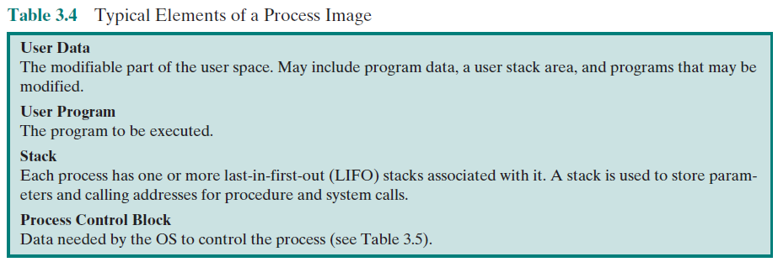

Slide 52
Process Attributes
We can group the process control block information into three general categories:
Process identification
Processor state information
Process control information
Notes:
A sophisticated multiprogramming system requires a great deal of information about each process.
Different systems will organize this information in different ways
For now, let us simply explore the type of information that might be of use to an OS without considering in any detail how that information is organized.
Table 3.5 in the book (not in this slide set) lists the typical categories of information required by the OS for each process.
We can group the process control block information into three general categories:
• Process identification
• Processor state information
• Process control information

Slide 53
Process Identification
Each process is assigned a unique numeric identifier.
Many of the other tables controlled by the OS may use process identifiers to cross-reference process tables
Notes:
In virtually all operating systems, each process is assigned a unique numeric identifier,
which may simply be an index into the primary process table (see Figure 3.11);
otherwise there must be a mapping that allows the OS to locate the appropriate tables based on the process identifier.
This identifier is useful in several ways.
Many of the other tables controlled by the OS may use process identifiers to cross-reference process tables.
For example,
The memory tables may be organized so as to provide a map of main memory with an indication of which process is assigned to each region.
Similar references will appear in I/O and file tables.
When processes communicate with one another, the process identifier informs the OS of the destination of a particular communication.
When processes are allowed to create other processes, identifiers indicate the parent and descendents of each process.
In addition to these process identifiers, a process may be assigned a user identifier that indicates the user responsible for the job.

Slide 54
Processor State Information
This consists of the contents of processor registers.
User-visible registers- that may be referenced by means of the machine language that the processor executes while in user mode
Control and status registers- registers that are employed to control the operation of the processor.
Program counter: Contains the address of the next instruction to be fetched
Condition codes: Result of the most recent arithmetic or logical operation (e.g., sign, zero, carry, equal, overflow)
Status information : Includes interrupt enabled/disabled flags, execution mode
Stack pointers- The stack pointer points to the top of the stack
Program status word (PSW)
contains status information
Example: the EFLAGS register on Pentium processors
Notes:
Processor state information consists of the contents of processor registers.
While a process is running the information is in the registers.
When a process is interrupted, all of this register information must be saved so that it can be restored when the process resumes execution. Nature and number of processes vary by processor design
Typically, the register set will include user-visible registers, control and status registers, and stack pointers.

Slide 55
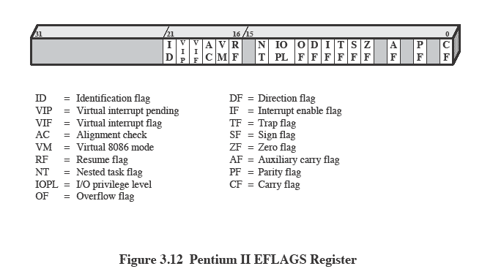
Pentium II EFLAGS Register
Also see Table 3.6
Notes:
All processor designs include a register or set of registers, often known as the program status word (PSW), that contains status information.
The PSW typically contain condition codes plus other status information.
A good example of a processor status word is that on Pentium processors, referred to as the EFLAGS register
This structure is used by any OS (including UNIX and Windows) running on a Pentium processor.

Slide 56
Process Control Information
This is the additional information needed by the OS to control and coordinate the various active processes.
Scheduling and State Information- Typical items of Information are:
Process state: Defines the readiness of the process to be scheduled for execution (e.g., running, ready, waiting, halted).
Priority:
Scheduling-related information:
Event: Identity of event the process is awaiting before it can be resumed
Data Structuring-
Inter-process Communication
Process Privileges- Processes are granted privileges in terms of the memory that may be accessed and the types of instructions that may be executed
Memory Management-
Resource Ownership and Utilization- Resources controlled by the process may be indicated, such as opened files. A history of utilization of the processor or other resources may also be included; this information may be needed by the scheduler
Notes:
This is the additional information needed by the OS to control and coordinate the various active processes.
The last part of Table 3.5 indicates the scope of this information.
As we examine the details of operating system functionality in succeeding chapters, the need for the various items on this list should become clear.

Slide 57
Role of the Process Control Block
The most important data structure in an OS
It defines the state of the OS
Process Control Block requires protection
A faulty routine could cause damage to the block destroying the OS’s ability to manage the process
Any design change to the block could affect many modules of the OS
Notes:
The process control block is the most important data structure in an OS.
Each process control block contains all of the information about a process that is needed by the OS.
The blocks are read and/or modified by virtually every module in the OS, including those involved with scheduling, resource allocation, interrupt processing, and performance monitoring and analysis.
One can say that the set of process control blocks defines the state of the OS.
Important design issue.
A number of routines within the OS will need access to information in process control blocks.
The difficulty is not access but rather protection.
Two problems present themselves:
A bug in a single routine, such as an interrupt handler, could damage process control blocks, which could destroy the system’s ability to manage the affected processes.
A design change in the structure or semantics of the process control block could affect a number of modules in the OS.

Slide 58
Roadmap
How are processes represented and controlled by the OS.
Process states which characterize the behaviour of processes.
Data structures used to manage processes.
Ways in which the OS uses these data structures to control process execution.
Discuss process management in UNIX SVR4.
Notes:
Progress indicator

Slide 59
Modes of Execution
Most processors support at least two modes of execution
User mode
Less-privileged mode
User programs typically execute in this mode
System mode
More-privileged mode
Kernel of the operating system
Notes:
The less-privileged mode is often referred to as the user mode, because user programs typically would execute in this mode.
Mention that System Mode is also known as
Control Mode
Kernel Mode
Protected Mode
Certain instructions can only be executed in the more-privileged mode.
Including reading or altering a control register, such as the program status word;
primitive I/O instructions;
Instructions that relate to memory management.
In addition, certain regions of memory can only be accessed in the more-privileged mode.
Table 3.7 lists the functions typically found in the kernel of an OS.
Questions: How does the processor know in which mode it is to be executing? And how does it change
Answer:
Typically a flag (single bit) in the program status word (PSW). This bit is changed in response to certain events.
Typically, when a user makes a call to an operating system service or when an interrupt triggers execution of an operating system routine, the mode is set to the kernel mode and, upon return from the service to the user process, the mode is set to user mode.

Slide 60
Process Creation
Once the OS decides to create a new process it
Assigns a unique process identifier
Allocates space for the process
Initializes process control block
Sets up appropriate linkages
Creates or expand other data structures

Slide 61
Mode Switching and Process Switching
mode switch changes the process privilege between modes like user mode and kernel mode while process switch changes the process state between different states.

Slide 62
Switching Processes
Several design issues are raised regarding process switching
What events trigger a process switch?
We must distinguish between mode switching and process switching.
What must the OS do to the various data structures under its control to achieve a process switch?

Slide 63
When to switch processes
A process switch may occur any time that the OS has gained control from the currently running process. Possible events giving OS control are:
Mechanism | Cause | Use
Interrupt | External to the execution of the current instruction | Reaction to an asynchronous external event
Trap | Associated with the execution of the current instruction | Handling of an error or an exception condition
Supervisor call | Explicit request | Call to an operating system function
Table 3.8 Mechanisms for Interrupting the Execution of a Process
Notes:
A process switch may occur any time that the OS has gained control from the currently running process.
Table 3.8 suggests the possible events that may give control to the OS.
Two kinds of system interrupts,
one is simply called an interrupt,
and the other called a trap.
“interrupts” are due to some sort of event that is external to and independent of the currently running process, such as the completion of an I/O operation.
With an ordinary interrupt, control is first transferred to an interrupt handler, which does some basic housekeeping and then branches to an OS routine that is concerned with
the particular type of interrupt that has occurred.
“Traps” relate to an error or exception condition generated within the currently running process, such as an illegal file access attempt.
With traps, the OS determines if the error or exception condition is fatal.
If so, then the currently running process is moved to the Exit state and a process switch occurs.
If not, then the action of the OS will depend on the nature of the error and the design of the OS.
It may attempt some recovery procedure or simply notify the user.
It may do a process switch or resume the currently running process.
Finally, the OS may be activated by a supervisor call from the program being executed.
For example, a user process is running and an instruction is executed that requests an I/O operation, such as a file open.
This call results in a transfer to a routine that is part of the operating system code. The use of a system call may place the user process in the Blocked state.

Slide 64
Change of Process State …
The steps in a process switch are:
Save context of processor including program counter and other registers
Update the process control block of the process that is currently in the Running state
Move process control block to appropriate queue – ready; blocked; ready/suspend
Select another process for execution
Update the process control block of the process selected
Update memory-management data structures
Restore context of the selected process
Notes:
If the currently running process is to be moved to another state (Ready, Blocked, etc.), then the OS must make substantial changes in its environment.
The steps involved in a full process switch are as follows:
1. Save the context of the processor, including program counter and other registers.
2. Update the process control block of the process that is currently in the Running state.
This includes changing the state of the process to one of the other states (Ready; Blocked; Ready/Suspend; or Exit). Other relevant fields must also be updated, including the reason for leaving the Running state and accounting information.
3. Move the process control block of this process to the appropriate queue (Ready;Blocked on Eventi; Ready/Suspend).
More next slide

Slide 65
Security Issues
An OS associates a set of privileges with each process.
Highest level being administrator, supervisor
A key security issue in the design of any OS is to prevent anything (user or process) from gaining unauthorized privileges on the system
Especially - from gaining root access(highest authority ).
Notes:
An OS associates a set of privileges with each process.
These privileges dictate what resources the process may access, including regions of memory, files, privileged system instructions, and so on.
Typically, a process that executes on behalf of a user has the privileges that the OS recognizes for that user.
A system or utility process may have privileges assigned at configuration time.
Typically the highest level of privilege is referred to as administrator, supervisor, or root, access. Root access provides access to all the functions and
services of the operating system.
With root access, a process has complete control of the system and can add or changes programs and files, monitor other processes, send and receive network traffic, and alter privileges.
A key security issue in the design of any OS is to prevent, or at least detect, attempts by a user or a piece of malicious software (malware) from gaining unauthorized privileges on the system and, in particular, from gaining root access.

Slide 66
System access threats
Intruders
Masquerader: An individual who is not authorized to use the computer and who penetrates a system’s access controls to exploit a legitimate user’s account
Misfeasor: A legitimate user who accesses data, programs, or resources for which such access is not authorized, or who is authorized for such access but misuses his or her privileges
Clandestine user: An individual who seizes supervisory control of the system and uses this control to evade auditing and access controls or to suppress audit collection
Malicious software (malware)- software used to disrupt computer operation, gather sensitive information, or gain access to private computer systems.
Notes:
Intruder:
Masquerader: An individual who is not authorized to use the computer and who penetrates a system’s access controls to exploit a legitimate user’s account
Misfeasor: A legitimate user who accesses data, programs, or resources for which such access is not authorized, or who is authorized for such access but misuses his or her privileges
Clandestine user: An individual who seizes supervisory control of the system and uses this control to evade auditing and access controls or to suppress audit collection

Slide 67
Countermeasures: Intrusion Detection
Intrusion detection systems are typically designed to detect human intruder and malicious software behaviour.
May be host or network based
Intrusion detection systems (IDS) typically comprise
Sensors
Analyzers
User Interface
Notes:
RFC 2828 defines an IDS as
A security service that monitors and analyzes system events for the purpose of finding, and providing real-time or near-real-time warning of, attempts to access system resources in an unauthorized manner.
Host-based IDS: Monitors the characteristics of a single host and the events occurring within that host for suspicious activity
Network-based IDS: Monitors network traffic for particular network segments or devices and analyzes network, transport, and application protocols to identify suspicious activity
An IDS comprises three logical components:
Sensors: Sensors are responsible for collecting data. The input for a sensor may be any part of a system that could contain evidence of an intrusion. Types of input to a sensor include network packets, log files, and system call traces. Sensors collect and forward this information to the analyzer.
Analyzers: Analyzers receive input from one or more sensors or from other analyzers. The analyzer is responsible for determining if an intrusion has occurred. The output of this component is an indication that an intrusion has occurred. The output may include evidence supporting the conclusion that an intrusion occurred. The analyzer may provide guidance about what actions to take as a result of the intrusion.
User interface: The user interface to an IDS enables a user to view output from the system or control the behaviour of the system. In some systems, the user interface may equate to a manager, director, or console component.

Slide 68
Sensors:
Sensors are responsible for collecting data.
The input for a sensor may be any part of a system that could contain evidence of an intrusion.
Types of input to a sensor include network packets, log files, and system call traces.
Sensors collect and forward this information to the analyzer.
Analyzers:
Analyzers receive input from one or more sensors or from other analyzers.
The analyzer is responsible for determining if an intrusion has occurred.
The output of this component is an indication that an intrusion has occurred.
The output may include evidence supporting the conclusion that an intrusion occurred.
The analyzer may provide guidance about what actions to take as a result of the intrusion.

Slide 69
User interface:
The user interface to an IDS enables a user to view output from the system or control the behaviour of the system.
In some systems, the user interface may equate to a manager, director, or console component.

Slide 70
Countermeasures: Authentication
Two Stages:
Identification-Presenting an identifier to the security system
Verification-Presenting or generating authentication information that confirms the binding between the entity and the identifier.
Four Factors:
Something the individual knows- password, PIN
Something the individual possesses- SMART CARD,KEYs
Something the individual is (static biometrics)- fingerprint, , retina, and face.
Something the individual does (dynamic biometrics)- recognition by voice pattern, handwriting characteristics, and typing rhythm.
Notes:
RFC 2828 defines user authentication as follows:
The process of verifying an identity claimed by or for a system entity. An authentication process consists of two steps:
Identification step: Presenting an identifier to the security system. (Identifiers should be assigned carefully, because authenticated identities are the basis for other security services, such as access control service.)
Verification step: Presenting or generating authentication information that corroborates the binding between the entity and the identifier.
Be prepared to elaborate on each factor with examples. Point out that each has weaknesses, but strength comes with multiple factors (e.g. password and token)
Four Factors:
Something the individual knows: Examples include a password, a personal identification number (PIN), or answers to a prearranged set of questions.
• Something the individual possesses: Examples include electronic keycards, smart cards, and physical keys. This type of authenticator is referred to as a token.
• Something the individual is (static biometrics): Examples include recognition by fingerprint, retina, and face.
• Something the individual does (dynamic biometrics): Examples include recognition by voice pattern, handwriting characteristics, and typing rhythm.

Slide 71
Countermeasures: Access Control
A policy governing access to resources
A security administrator maintains an authorization database
The access control function consults this to determine whether to grant access.
An auditing function monitors and keeps a record of user accesses to system resources.
Notes:
Access control implements a security policy that specifies who or what (e.g., in the case of a process) may have access to each specific system resource and the type of access that is permitted in each instance.
A security administrator maintains an authorization database that specifies what type of access to which resources is allowed for this user.
The access control function consults this database to determine whether to grant access.
An auditing function monitors and keeps a record of user accesses to system resources.

Slide 72
Countermeasures: Firewalls
Traditionally, a firewall is a dedicated computer that:
interfaces with computers outside a network
has special security precautions built into it to protect sensitive files on computers within the network.
Notes:
Firewalls can be an effective means of protecting a local system or network of systems from network-based security threats while at the same time affording access to the outside world via wide area networks and the Internet.
Traditionally, a firewall is a dedicated computer that interfaces with computers outside a network and has special security precautions built into it in order to protect sensitive files on computers within the network.
It is used to service outside network, especially Internet, connections and dial-in lines. Personal firewalls that are implemented in hardware or software, and associated with a single workstation or PC, are also common.

Slide 73
Roadmap
How are processes represented and controlled by the OS.
Process states which characterize the behaviour of processes.
Data structures used to manage processes.
Ways in which the OS uses these data structures to control process execution.
Discuss process management in UNIX SVR4.
Notes:
Progress indicator

Slide 74
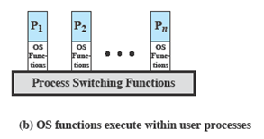
Unix SVR4 System V Release 4
Uses the model of fig3.15b where most of the OS executes in the user process
System Processes - Kernel mode only
User Processes
User mode to execute user programs and utilities
Kernel mode to execute instructions that belong to the kernel.
Notes:
UNIX System V makes use of a simple but powerful process facility that is highly visible to the user.
System processes run in kernel mode and execute operating system code to perform administrative and housekeeping functions, such as allocation of memory and process swapping.
User processes operate in:
user mode to execute user programs and utilities
in kernel mode to execute instructions that belong to the kernel.
A user process enters kernel mode by issuing a system call, when an exception (fault) is generated, or when an interrupt occurs.

Slide 75
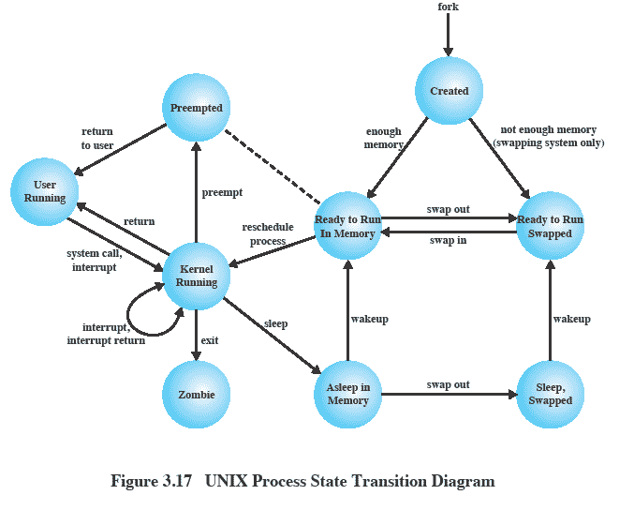
UNIX Process State Transition Diagram
Notes:
A total of nine process states are recognized by the UNIX SVR4 operating system;
This figure is similar to Figure 3.9b, with the two UNIX sleeping states corresponding to the two blocked states.
Point out that:
UNIX employs two Running states to indicate whether the process is executing in user mode or kernel mode.
Two states are essentially the same: (Ready to Run, in Memory) and (Pre-empted) as indicated by the dotted line. The distinction is made to emphasize the way in which the pre-empted state is entered. When a process is running in kernel mode (as a result of a supervisor call, clock interrupt, or I/O interrupt), there will come a time when the kernel has completed its work and is ready to return control to the user program. At this point, the kernel may decide to pre-empt the current process in favour of one that is ready and of higher priority. In that case, the current process moves to the pre-empted state. However, for purposes of dispatching, those processes in the pre-empted state and those in the Ready to Run, in Memory state form one queue.

Slide 76
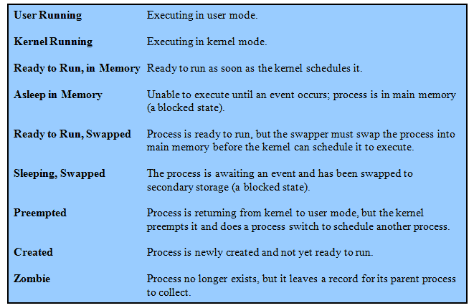
UNIX Process States

Slide 77
A Unix Process
A process in UNIX is a set of data structures that provide the OS with all of the information necessary to manage and dispatch processes.
See Table 3.10 which organizes the elements into three parts:
user-level context,
register context, and
system-level context.

Slide 78
Process Creation
Process creation is by means of the kernel system call,fork( ).
This causes the OS, in Kernel Mode, to:
Allocate a slot in the process table for the new process.
Assign a unique process ID to the child process.
Copy of process image of the parent, with the exception of any shared memory.

Slide 79
Process Creation cont…
Increment the counters for any files owned by the parent, to reflect that an additional process now also owns those files.
Assign the child process to the Ready to Run state.
Returns the ID number of the child to the parent process, and a 0 value to the child process.

Slide 80
After Creation
After creating the process the Kernel can do one of the following, as part of the dispatcher routine:
Stay in the parent process.
Transfer control to the child process
Transfer control to another process.
Notes:
When the kernel has completed these functions it can do one of the following, as part of
the dispatcher routine:
• Stay in the parent process. Control returns to user mode at the point of the fork call of the parent.
• Transfer control to the child process. The child process begins executing at the same point in the code as the parent, namely at the return from the fork call.
• Transfer control to another process. Both parent and child are left in the Ready to Run state.

